Slide 1
NFEC Forum May 2017
Pearson update

Slide 2

BTEC Level 1
Latest news
Image by Ben Wiseman
New graded Level 1 Introductory qualifications available for first teaching from September 2016
Meanwhile, we are working on extending current QCF specs until December 2018.
2

Slide 3
What do the new courses look like?
  2 personal skills units
  Internally assessed
  60 GLH in total
  3 sector units
  Internally assessed
  120 GLH in total
Certificate
180 GLH
=
+
360 GLH
  4 personal skills units
  Internally assessed
  One synoptic unit
  120 GLH in total
  6 sector units
  Internally assessed
  240 GLH in total
Diploma
=
+

Slide 4
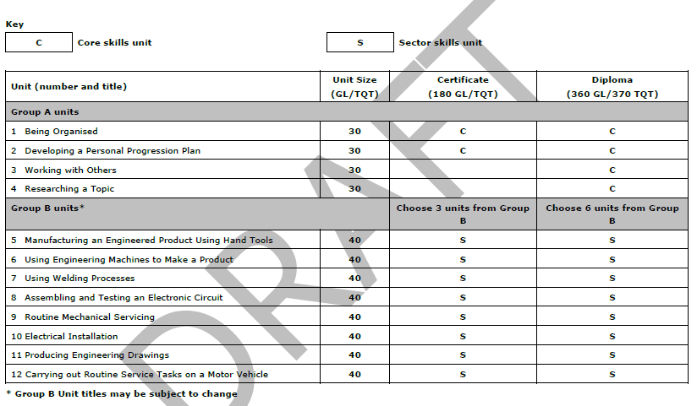
Structure of the new BTEC L1 Introductory qualifications in Engineering

Slide 5
Level 2:
BTEC Firsts
BTEC Level 2 Technicals

Slide 6
Which BTECs can you teach, and when?
 | Level 2 qualifications you can teach now | New Level 2 qualifications you can teach from September 2017
 | BTEC Firsts (14–19) Extended until 31st December 2019 | BTEC Level 2 Technicals (Post-16)
 |  | Provisional titles for Technical Certificate (16–19) performance measures
Engineering | BTEC Level 1/Level 2 Firsts in Engineering Award Award in Engineering Design and Product Investigation Award in Engineering Electronics and Computer Control Technologies Extended Certificate Diploma BTEC Level 2 Firsts in Vehicle Technology (QCF) Extended Certificate Diploma | BTEC Level 2 Technicals for Engineering Diploma in Engineering
Information for BTEC Level 2 Technicals is provisional and subject to regulation/accreditation.

Slide 7
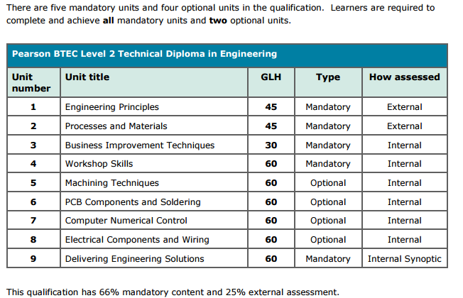
BTEC L2 Technical Diploma in Engineering
DRAFT
Specification and sample assessments
Notes:
For Unit 1 and Unit 2, onscreen tests are available on demand starting from January 2018. These tests use a range of question types, including examiner-marked. As tests have a full marking process, results for individual learners will be released once the process is complete and the time to results issue will vary. Learners must be prepared for external assessment by the time they undertake it. In preparing learners for assessment you will want to take account of required learning time, the relationship with any other external assessments and opportunities for resits. Learners who take an external assessment and who do not perform as expected may have one further opportunity using a later external assessment. Learners cannot take a further assessment until they have a result from the first assessment. Learners who attempt an external assessment twice will have the better of the grades achieved used in the final grade calculation for the qualification.

Slide 8

BTEC Higher National Qualifications in Engineering (RQF)
8

Slide 9
New specifications: First teach 2017
HNC & HND:
Electrical & Electronic
General
Manufacturing
Mechanical
Operations
HNC & HND in Nuclear Engineering
Electrical and Electronic
Mechanical
HNC & HND in Aeronautical Engineering

Slide 10

Overview
Higher National Certificate (HNC) is a Level 4 qualification made up of 120 credits.
Higher National Diploma (HND) is a Level 4 and Level 5 qualification made up of 240 credits.
Usually studied full-time over two years, or part-time over four years.
It is expected that an HND student would have achieved at least 90 credits at Level 4 before progressing to Level 5 units. This allows for the students to submit the remaining 30 credits at Level 4 while undertaking their Level 5 study.
10

Slide 11
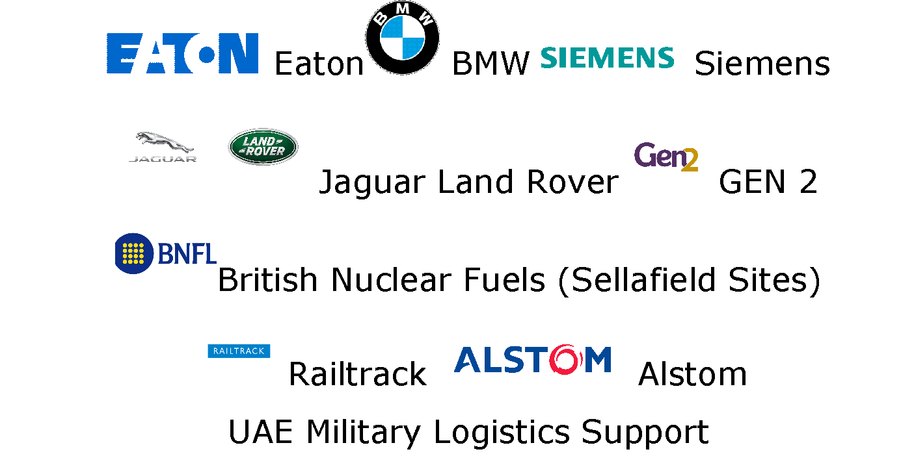
Collaborative Development
with Employers
Presentation Title Arial Bold 7 pt
11

Slide 12
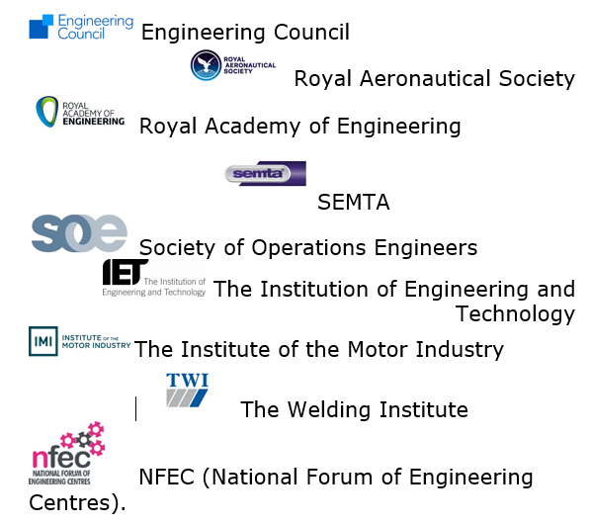
Professional Body
and Sector Skills
Presentation Title Arial Bold 7 pt
12

Slide 13

Collaborative Development
with HE/ FE Institutions
Presentation Title Arial Bold 7 pt
13

Slide 14

Professional Recognition
Units and specialist pathways selected are mapped against Professional Bodies requirements.
Pearson BTEC Higher Nationals in Engineering (General, Nuclear & Aeronautical) are set at Level 4 and 5 and have been written with reference to the Engineering Council specification for Level 3 and 6.
Holders of a BTEC Higher National in Engineering (General, Nuclear & Aeronautical) meet the academic requirements for the Engineering Council Engineering Technician Standard (EngTech).
14

Slide 15

Professional Body and Sector Skills Council Recognition
We are working with the Professional Bodies and Sector Skills Councils that represent the subject areas covered by the new qualifications to seek approval and endorsement and will announce arrangements as they become available.
Semta, the Sector Skills Council responsible for the majority of the areas of engineering covered by the new Higher Nationals has already approved and endorsed the new qualifications at levels 4 and 5.
15

Slide 16
Assessment Criteria and Methodology
Assessments are graded Pass, Merit and Distinction.
A key change is Merit and Distinction criteria being provided to centres in addition to the Pass criteria.
Pass criteria are set as the threshold of meeting the Learning Outcome for each unit.
Merit and Distinction criteria define the depth and breadth of knowledge and understanding the student has evidenced in meeting Pass criteria.
The scaffolding principle supports the development of deeper learning and stretches and challenges the student.

Slide 17
Engineering, Core Units - All pathways
HNC
Core
HND
Core
Engineering Design (15 credits)
Engineering Mathematics (15 credits)
Engineering Science (15 credits)
Managing a Professional Engineering Project (15 credits - assessed via Pearson-set assignment)
Professional Engineering Management (15 credits - assessed via Pearson-set assignment)
Research Project (30 credits)
There are a total of 64 other Specialist and Optional units across all of the Engineering pathways, allowing flexibility, specialisation and in-depth subject coverage.
All units are newly written and supported by Sample Assessment Materials and Schemes of Work.

Slide 18

Engineering - main pathway level 4 units
At Level 4 students study the main core units:
Engineering Design
Engineering Mathematics
Engineering Science
Managing a Professional Engineering Project
Students on the following will study:
Electrical and Electronic Engineering pathway
- 4 Core, 1 Specialist and 3 Optional units;
General Engineering pathway
- 4 Core, 4 Optional units;
Manufacturing Engineering pathway
- 4 Core, 2 Specialist, 2 Optional units;
Mechanical Engineering pathway
- 4 Core, 2 Specialist, 2 Optional units;
Operations Engineering pathway
- 4 Core, 4 Optional units

Slide 19
Engineering - main pathway level 4 units
Engineering Design (c)
Engineering Mathematics (c)
Engineering Science (c)
Managing a Professional Engineering Project (c)
Renewable Energy
Mechatronics
Machining and Processing of Engineering Materials
Mechanical Principles
Materials, Properties and Testing
Mechanical Workshop Practices
Fluid Mechanics
Engineering Management
Fundamentals of Thermodynamics and Heat Engines
Production Engineering for Manufacture

Slide 20
…Continued
Automation, Robotics and PLC’s
Instrumentation and Control Systems
Quality and Process Improvement
Maintenance Engineering
Electrical and Electronic Principles
Digital Principles
Electrical Machines
Electronic Circuits and Devices
Computer Aided Design and Manufacture (CAD/CAM)
Electro, Pneumatic and Hydraulic Systems
Operations and Plant Management
Electrical Systems and Fault Finding
CAD for Maintenance Engineers
Some of the above units may appear in some pathways as Specialist Units, in which case their inclusion is mandatory. Please refer to the detailed pathway specification for further guidance.

Slide 21
Engineering - main pathway level 5 units
At Level 5 students study the mandatory core units:
Research Project
Professional Engineering Management
Students on the following will study:
Electrical and Electronic Engineering pathway
- 2 Core, 3 Specialist, 2 Optional units
General Engineering pathway
- 2 Core, 2 Specialist, 3 Optional units
Manufacturing Engineering pathway
- 2 Core, 3 Specialist, 2 Optional units
Mechanical Engineering pathway
- 2 Core, 3 Specialist, 2 Optional units
Operations Engineering pathway
- 2 Core, 4 Specialist, 1 Optional units

Slide 22
Engineering - main pathway level 5 units
Research Project
Professional Engineering Management
Advanced Mechanical Principles
Virtual Engineering
Further Thermodynamics
Further Mathematics
Commercial Programming Software
Distributed Control Systems
Further PLC’s
Machines and Drives
Industrial Power, Electronics and Storage
Industrial Systems
Embedded Systems

Slide 23
…Continued
Analogue Electronic Systems
Manufacturing Systems Engineering
Lean Manufacturing
Advanced Manufacturing Technology
Sustainability
Further Electrical, Electronic and Digital Principles
Utilisation of Electrical Power
Further Control Systems Engineering
Heating, Ventilation and Air Conditioning (HVAC)
Industrial Studies
Thermo Fluids
Some of the above units may appear in some pathways as Specialist Units, in which case their inclusion is mandatory. Please refer to the detailed pathway specification for further guidance.

Slide 24

Nuclear Engineering units
Level 4 - For both Electrical & Electronic and Mechanical Pathways students study:
  4 Core, 3 Specialist,1 Optional Units
Fundamentals of Nuclear Power
Level 5 - For the level 5 pathway students study:
2 Core, 1 Specialist, 4 Optional units
Nuclear Reactor Engineering
Nuclear Reactor Chemistry
Radiation Protection Technology
Nuclear Reactor Materials
Nuclear Fuel Cycle Technology
Nuclear Decommissioning and Radioactive Waste Management Technology
Nuclear Criticality Control
Nuclear Safety Case Development

Slide 25
Aeronautical Engineering level 4 units
At level 4 students study:
4 Core, 1 Specialist, 3 Optional Units
Aircraft Aerodynamics (S)
Aircraft Electrical Power and Distribution Systems
Airframe Mechanical Systems
Composite Materials for Aerospace Applications
Turbine Rotary Wing Mechanical and Flight Systems

Slide 26
Aeronautical Engineering level 5 units
Level 5 pathway students study:
2 Core, 2 Specialist, 3 Optional Units.
Aircraft Flight Control Systems
Aircraft Propulsion Principles and Technology
Aircraft Structural Integrity
Avionic Systems
Aircraft Gas Turbine Engine Design and Performance
Advanced Composite Materials for Aerospace Applications
Advanced Turbine Rotary Wing Mechanical and Flight Systems

Slide 27
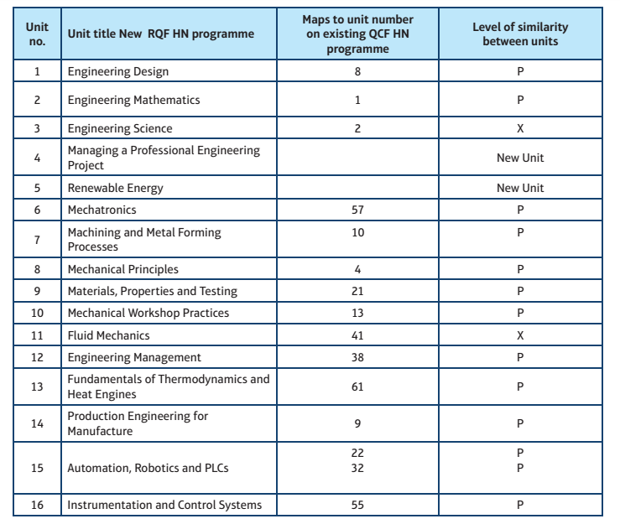
Mapping

Slide 28
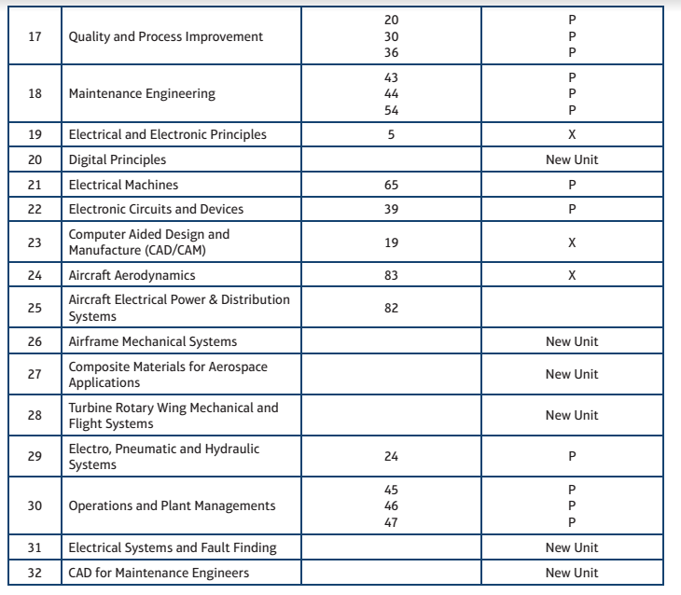
Mapping continued…

Slide 29
For your consideration
Identify new curriculum offer to meet localised needs. Which pathways and structure?
Ensure new offer is logged with UCAS and arrange transfer of existing applications.
Communicate changes to existing applicants in the process if you have made significant changes to curriculum offer.
Update marketing promotional material e.g. website information, online prospectus etc
Disseminate information to teaching teams. Arrange planning sessions.
Consider timetabling and resourcing of running parallel units for both cohorts in year one and two.
Communicate transition arrangements, if necessary, to existing cohorts.
Devise an academic operational calendar for 2017/18 for quality assurance processing.
Amend student handbook for 2017/18.

Slide 30
Local contacts & support
Curriculum Development Manager
bridget.stait@pearson.com
Sue Smith- Vocational Quality Advisor
Helen Elshaw for Gloucestershire
qualitynominees@pearson.com
Regional Account Manager
nigel.lofthouse@pearson.com
Jason.davis@pearson.com for Gloucestershire
HN specific queries:Ian.Moores@pearson.com
highernational@pearson.com
Presentation Title Arial Bold 7 pt
30

